Slide 1


Association for Computing Machinery: Basics of Circuitry

Slide 2
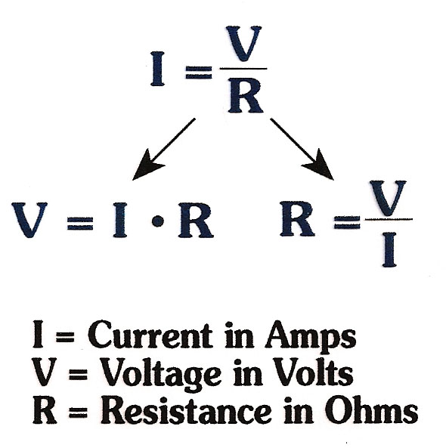
Ohm’s Law
Current between two points is proportional to the voltage between those two points, and is inversely proportional to resistance.
Current = the rate that the charge flows
Voltage = the difference of charge between two points
Resistance = how much it resists the charge’s flow

Slide 3
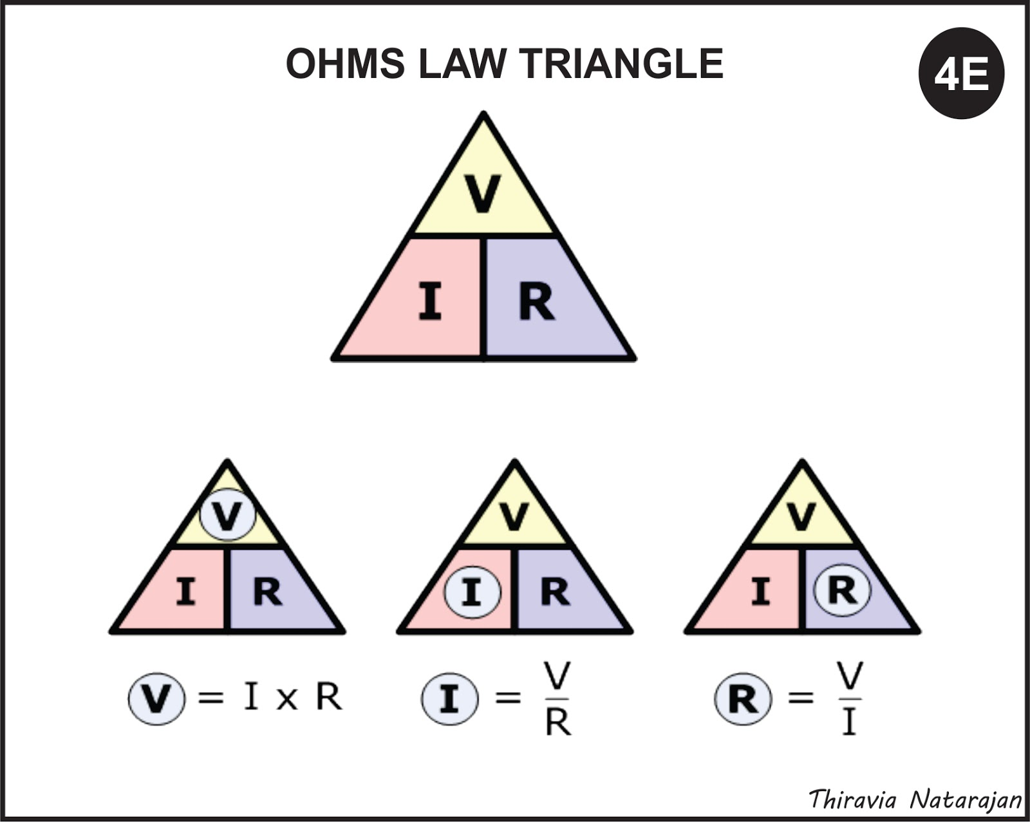

Slide 4
You have 2 AA batteries which provide 1.5V power each. You want to light up an LED that requires 1.9V of power. An LED has a maximum current rating of 30mA. Find the maximum ohms where the LED can still achieve full brightness.
(1.5V * 2) – 1.9V = 1.1V //Power Supply – Required power
30mA * 1A/1000mA = 30A/1000 = 0.03A //Convert mA to Amps
R = V/I = 1.1/0.03 = 36.67Ω //Plug and solve

Slide 5
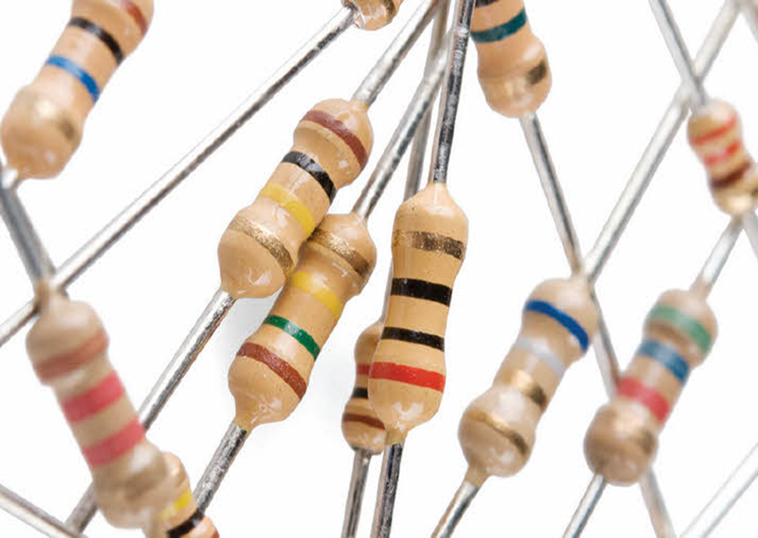
Resistors
They resist things.
Keeps your circuit from exploding.
Michael Bay resistant.

Slide 6
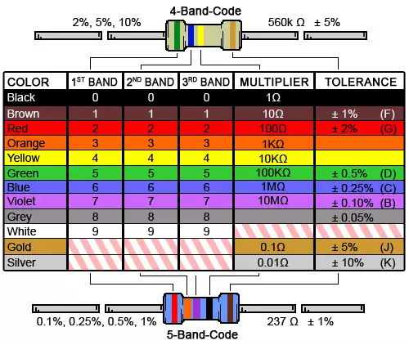
Resistor Color Code Calculator

Slide 7
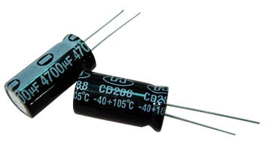
Capacitors
Are used to store a charge
Can discharge to give a kick start
Can be used as filters to provide smoother current
Positive leg is longer, negative has a “-” marking on the can
Are measured in microfarads
1,000,000 microfarads = 1 coulomb/volt
How Capacitors Work

Slide 8
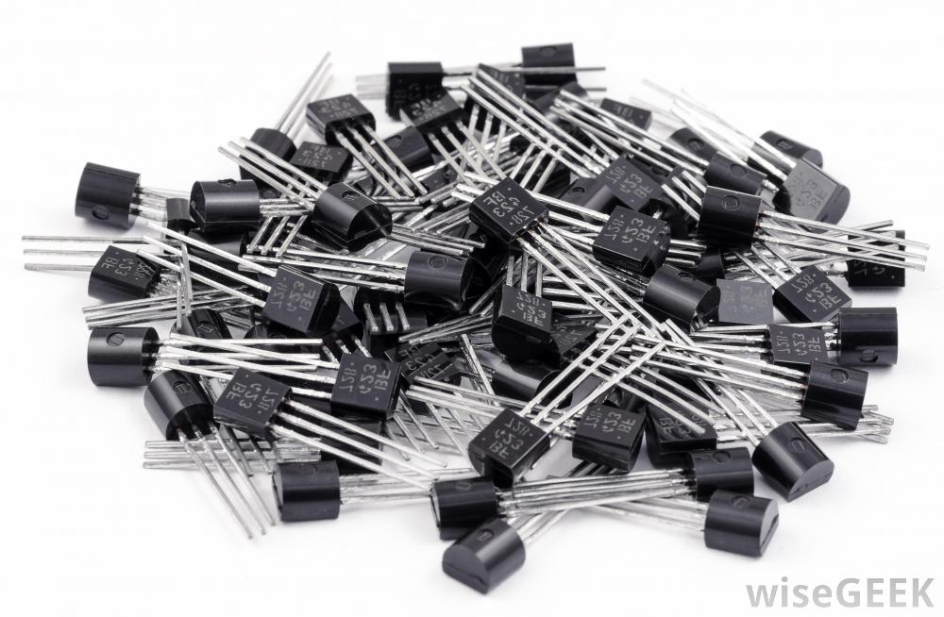
Transistors
Are used as a switch
Two main types – PNP and NPN
How Transistors Work

Slide 9
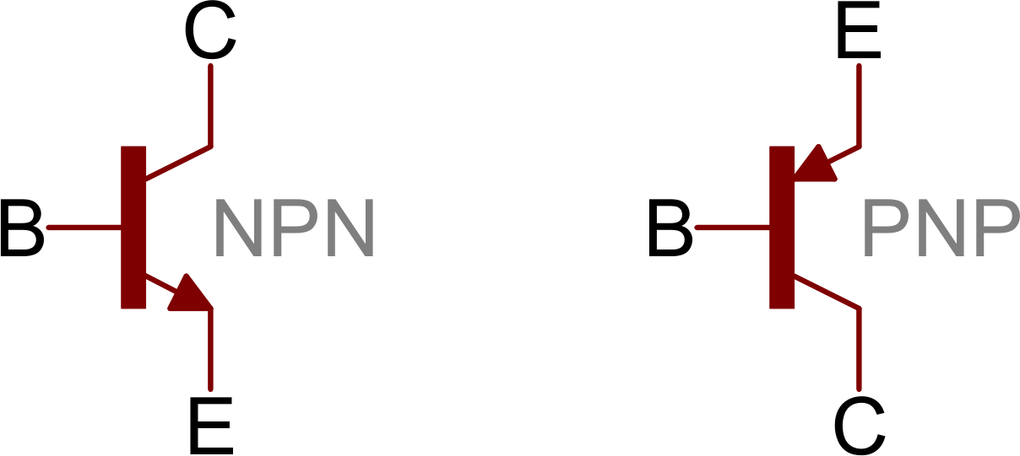
C = Collector (Receives)
B = Base
E = Emitter (Sends)

Slide 10
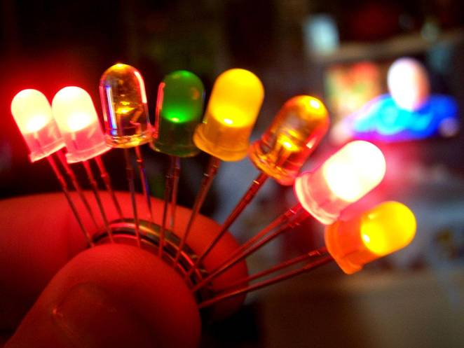
LED Voltage
Red - 1.7V low, 1.9V high
Yellow – 2V
Green – 2.1V
White/ Blue – 3.2-3.4V
Longer leg is positive

Slide 11
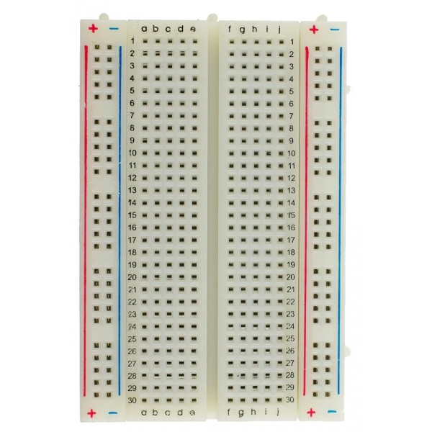
Breadboards
Horizontal holes are linked together but not across the middle
The two columns on the ends are used for power supplies and are linked vertically
Smaller boards don’t have power supply columns

Slide 12
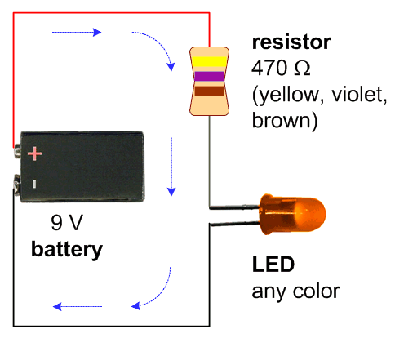
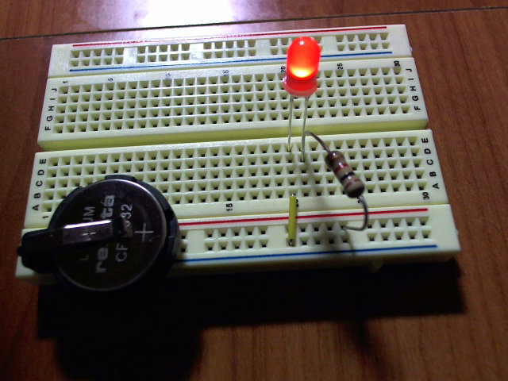

Slide 13



Go forth and make!

